Slide 1

Analyzing Retail Insights from SuperStore
NAME:Anandha Baskar A
AICTE ID:STU626e115d8bce01651380573
COLLEGE :IFET College of Engineering

Slide 2

PROBLEM STATEMENT
In the Analyzing Retail Insights from SuperStore Data, understanding the distribution of sales and profitability across various dimensions is vital for strategic decision-making. Our analysis will identify sales distribution across regions, segments, and product categories to pinpoint revenue drivers. We will conduct a profitability analysis to highlight high-profit and low-profit areas, enabling targeted business optimizations. Additionally, examining regional performance will help us understand which regions excel or underperform and why. Finally, by investigating city-level performance and customer segmentation, we can develop targeted strategies to boost sales and profitability, providing actionable insights to enhance overall business performance.

Slide 3
Project Description
This project analyzes SuperStore data to uncover insights into sales and profitability across different regions, customer segments, and product categories. By examining key metrics and visualizing data trends, we aim to identify revenue drivers and high-profit areas. The analysis will highlight regional and city-level performance, enabling targeted strategies for business optimization. Additionally, customer segmentation will provide insights for tailored marketing efforts. The comprehensive analysis will deliver actionable recommendations to enhance overall business performance.

Slide 4

WHO ARE THE END USERS?
Retail Management
Sales and Marketing Teams
Financial Analysts
Regional Managers
Product Managers
Business Development Teams
Store Managers

Slide 5

Technology Used
Programming Language: Python
IDE: Jupyter Notebook
Data Computation: pandas, numpy
Data Visualization: Matplotlib

Slide 6
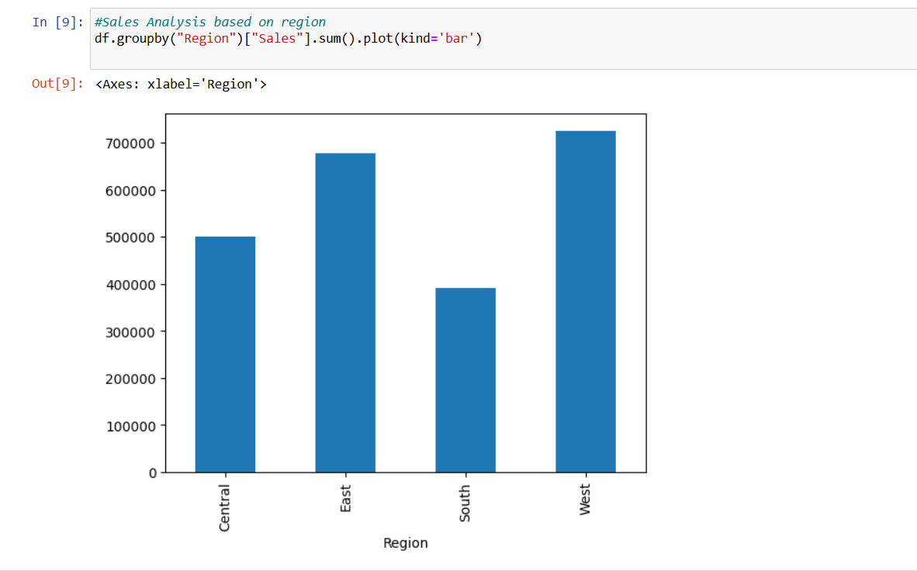
RESULTS
[Add screen shots of your code ]
GitHubLink

Slide 7
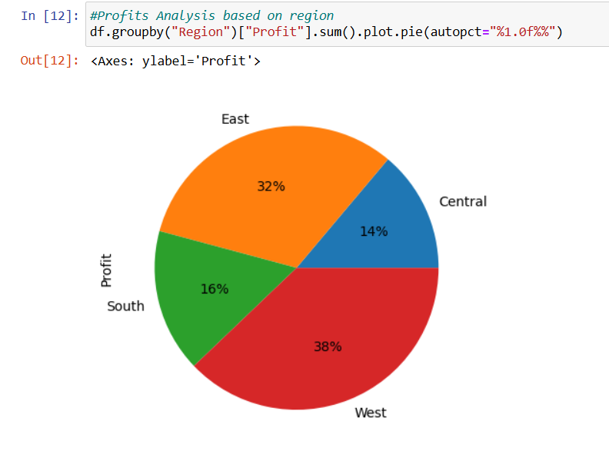
RESULTS
[Add screen shots of your code ]
Demo Link
GitHubLink

Slide 8
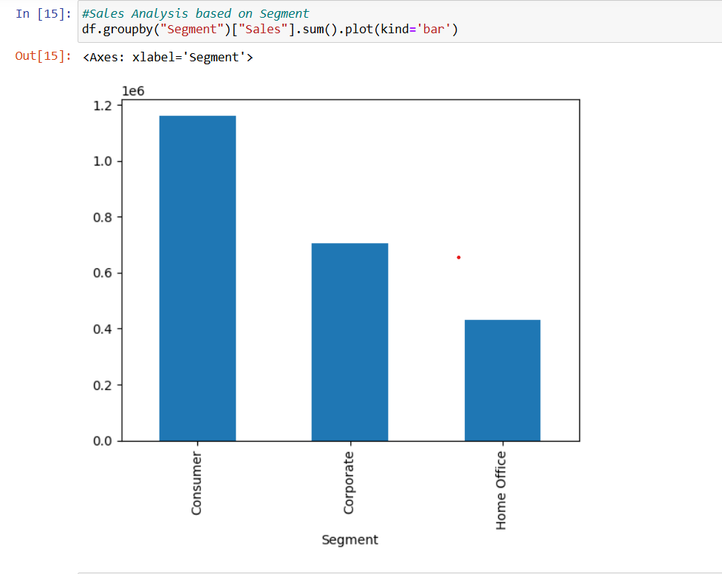
RESULTS
[Add screen shots of your code ]
k
GitHubLink

Slide 9
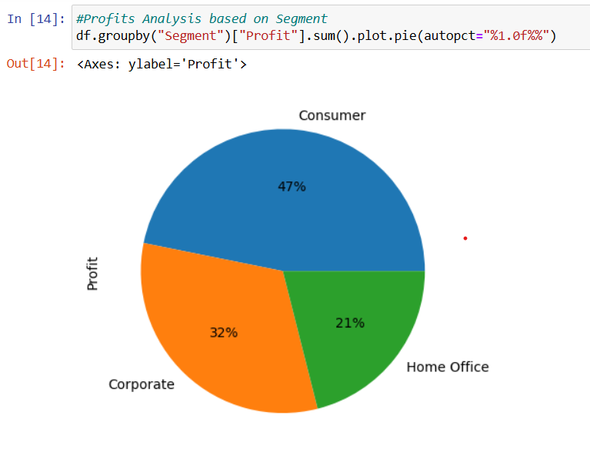
RESULTS
[Add screen shots of your code ]
GitHubLink

Slide 10
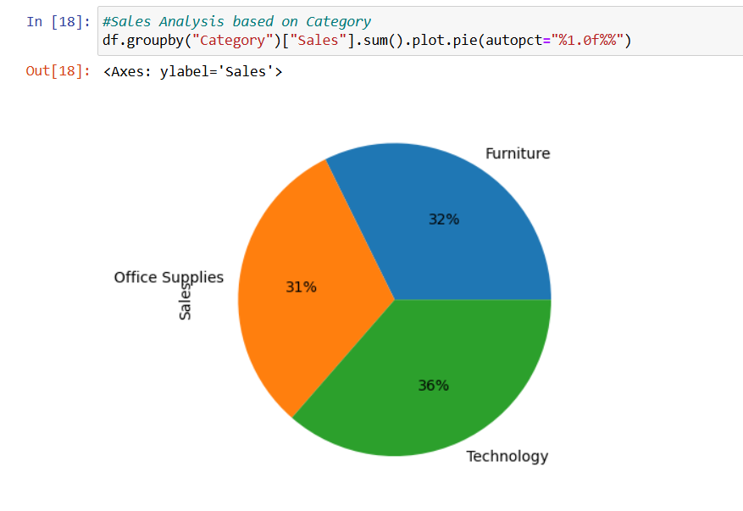
RESULTS
[Add screen shots of your code ]
Demo Link
GitHubLink

Slide 11
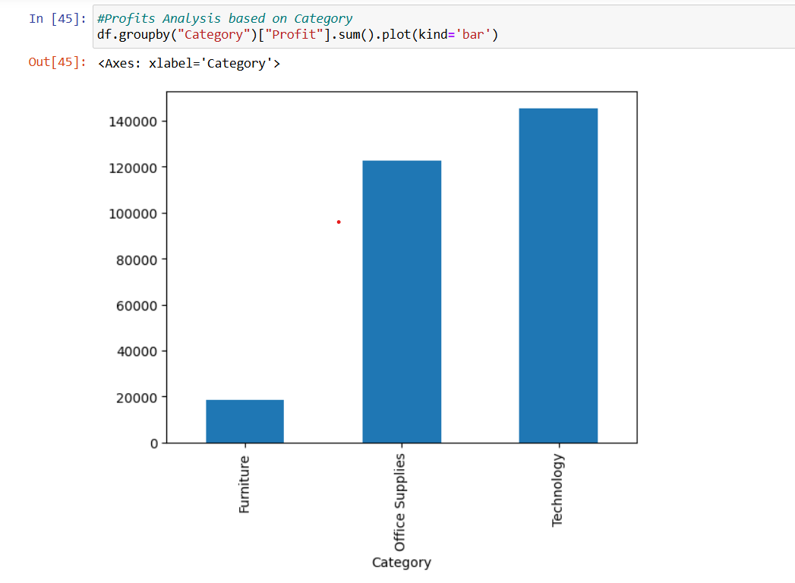
RESULTS
[Add screen shots of your code ]
GitHubLink

Slide 12
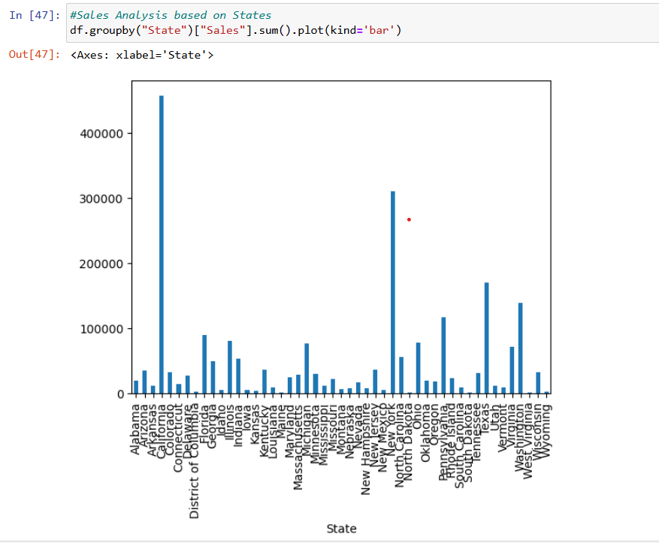
RESULTS
[Add screen shots of your code ]
GitHubLink

Slide 13
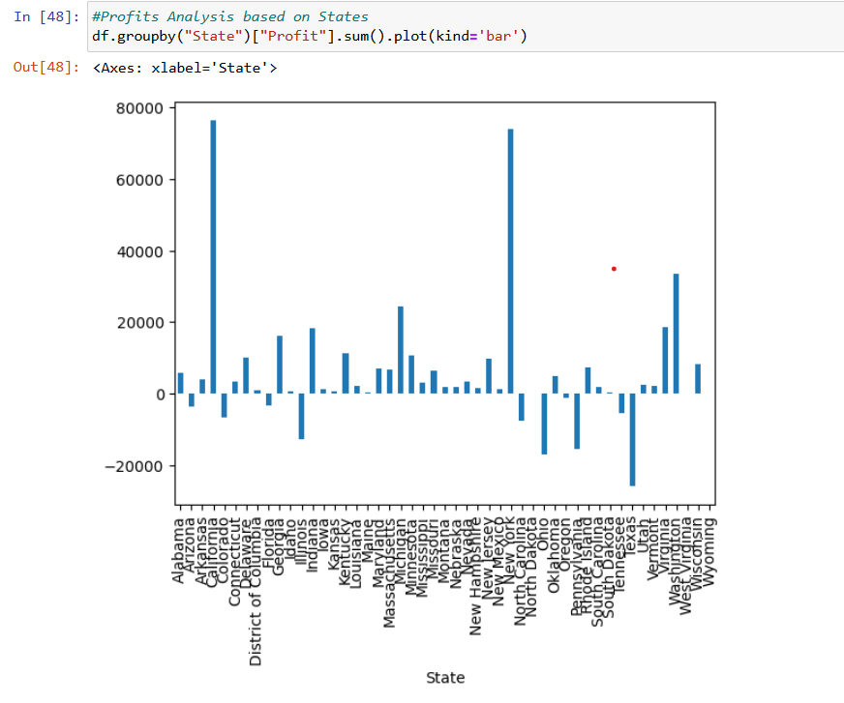
RESULTS
[Add screen shots of your code ]
GitHubLink

Slide 14
Thank you
.
.
GitHubLink

